Slide 1
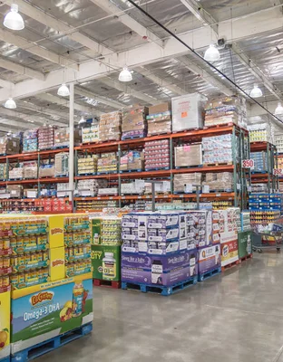

NorthWind Traders Capstone Project
Siddhant Dhurve

Slide 2

Introduction
The Northwind database contains the sales data for a fictitious company called “Northwind Traders,” which imports and exports specialty foods from around the world.
The data covers multiple years of business operations, including order history and interactions with customers, enabling a comprehensive analysis of customer behaviour and preferences over time.

Slide 3
Objective
1
2
3
4
5
Analyzing wholesale food Trader
Sales Pattern
Order Trend
Visualization
Valuable insights
Sales Growth
Customer
Product
Supplier
Shipper
behavior
Conclusion

Slide 4
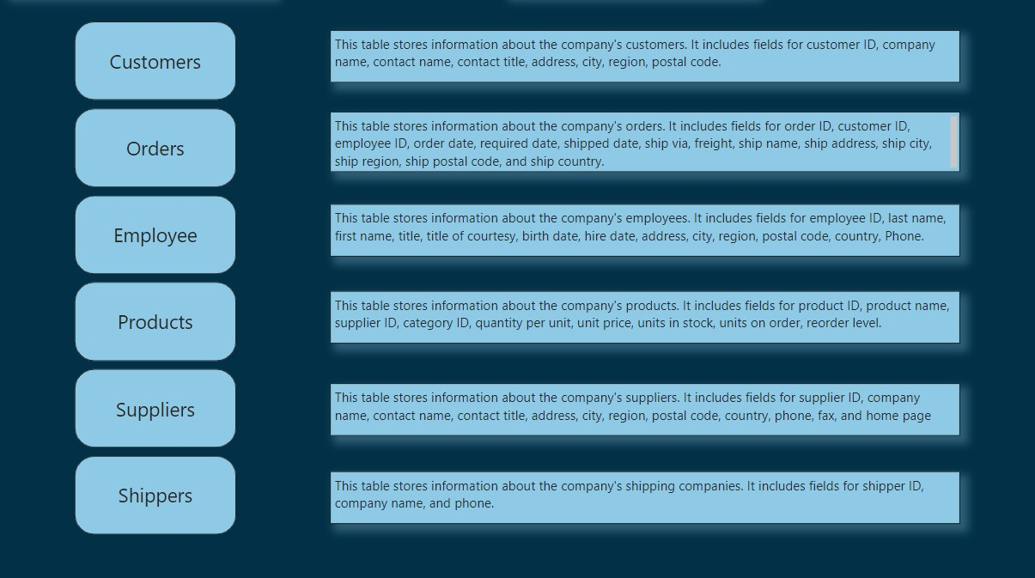
Data Dictionary

Slide 5
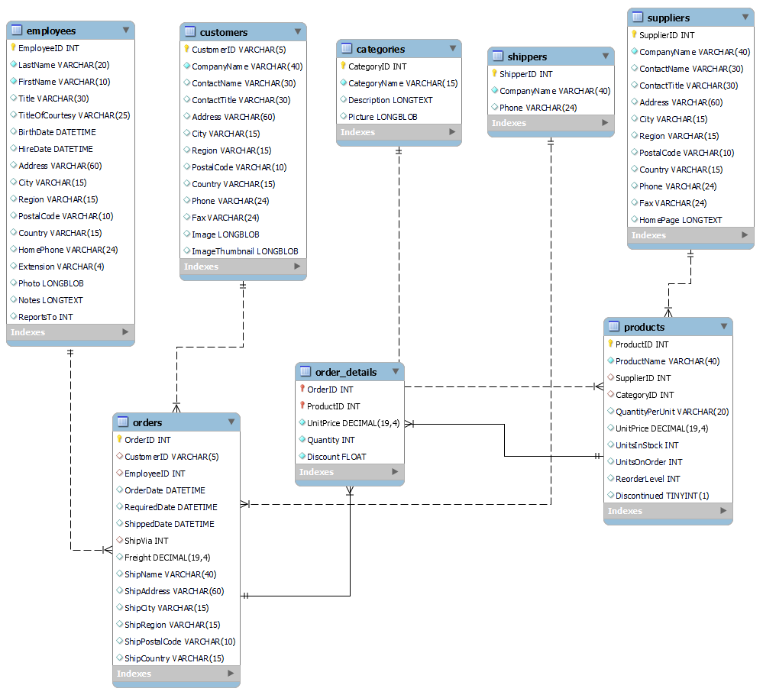
ER Diagram

Slide 6
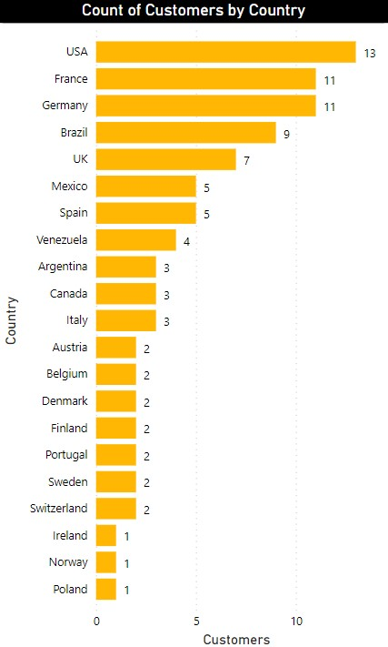
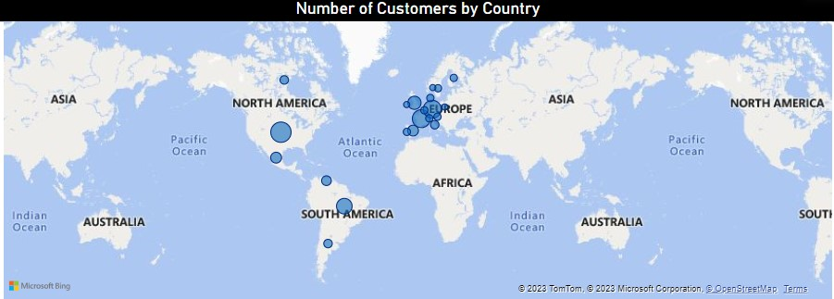
How does customer distribution vary across different regions or customer segments? Can we visualize it on a map or bar chart?
Yes we can, As shown in the below chart and map. Most of our customers come from USA, France and Germany And Least are from Ireland, Norway and Poland.

Slide 7
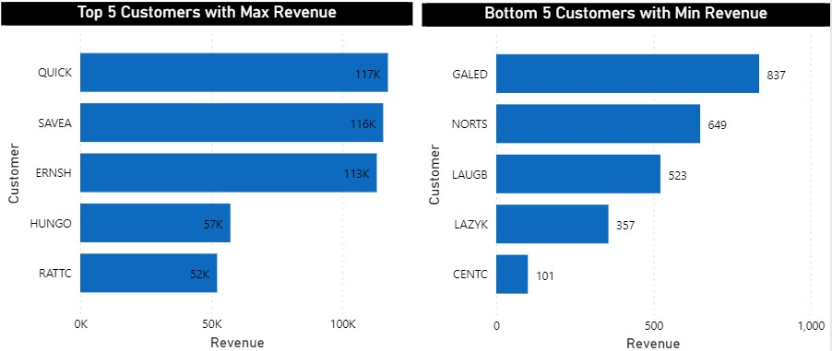
Can we visualize the distribution of customer demographics such as age, gender, or income using histograms or pie charts?
As our customers are companies from different regions we can visualize demographics by country that we have already seen
then we have data of revenue generated by customers from that we can visualize which are in Top & Bottom 5.

Slide 8
What are the key factors influencing customer retention or loyalty based on the dataset?
The key factors for customers retention are mainly service, product quality and packaging. But according to dataset we can conclude the number of times customer visited which defines customers loyalty and order delivery status also influence customer retention.

Slide 9
How do customer preferences vary based on their location or demographics? Can we explore this through interactive visualizations?
The customers preference based on the near location of market first within country if not available then nearby country or region where product quality and packaging with service matters.

Slide 10
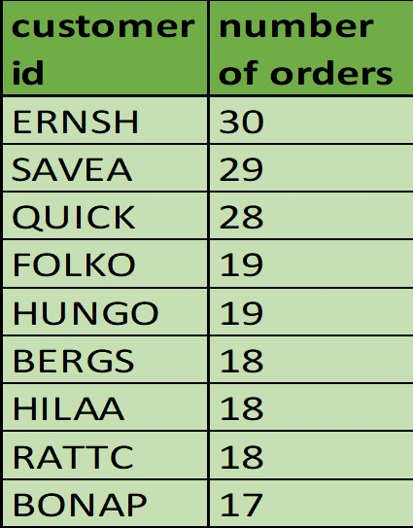
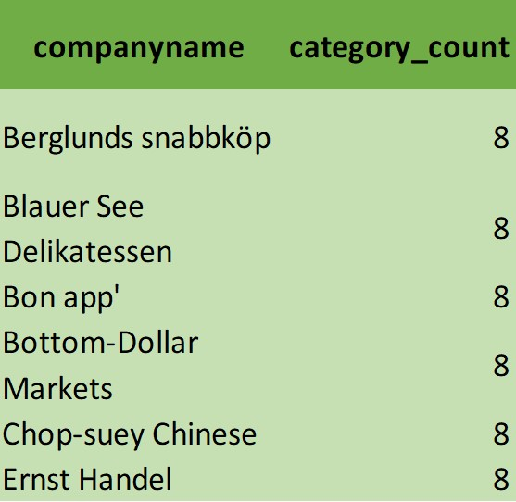
Are there any interesting patterns or clusters in customer behavior that can be visualized to identify potential market segments?
Interesting Patterns can be conclude from dataset like customers who deals in every category, those who orders more than 10 times within given time span, top and bottom customers by sales.

Slide 11
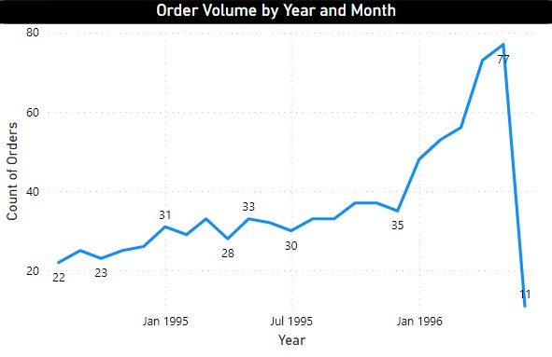
How does order volume change over time? Can we create a time series chart or stacked bar chart to visualize it?
The Following time series chart shows order volume over time. From chart we can observe that order volume pattern shows the increasing trend over the time. In the month of May 1996 got highest orders.

Slide 12
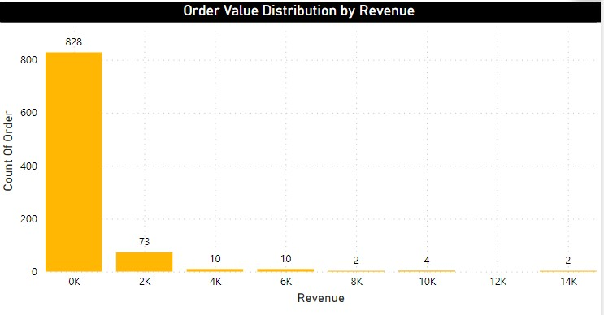
What is the distribution of order values? Can we create a histogram or box plot to display it?
Distribution of order values show max order which are around 828 ranges from 0 to $2000 then it decreases gradually.

Slide 13
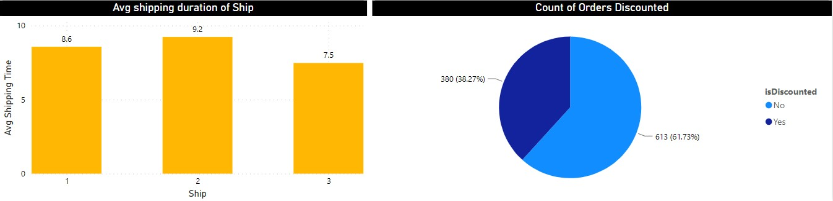
Can we visualize the average order processing time or shipping duration using a bar chart or box plot?
The Average Shipping duration of order by shippers has almost same around 8-9 days.

Slide 14
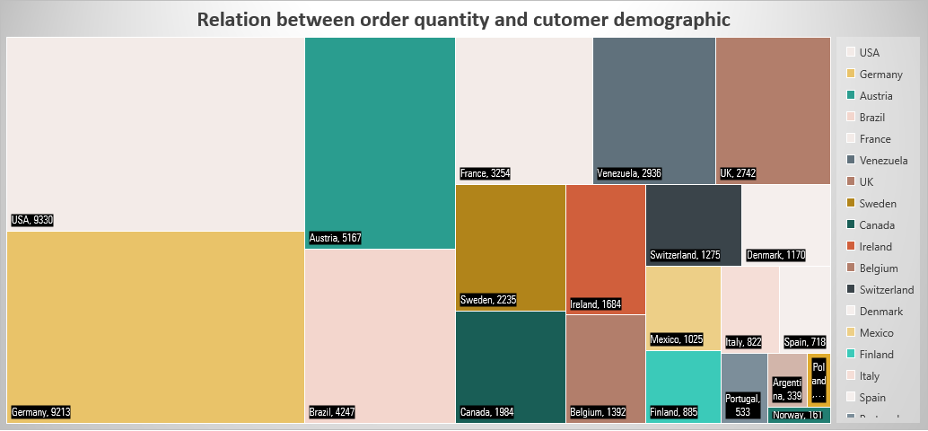
Are there any correlations between order size and customer demographics or product categories? Can we explore this visually using scatter plots or heatmaps?
From the chart it shows the direct relationship of order size and number of customer from particular region.

Slide 15
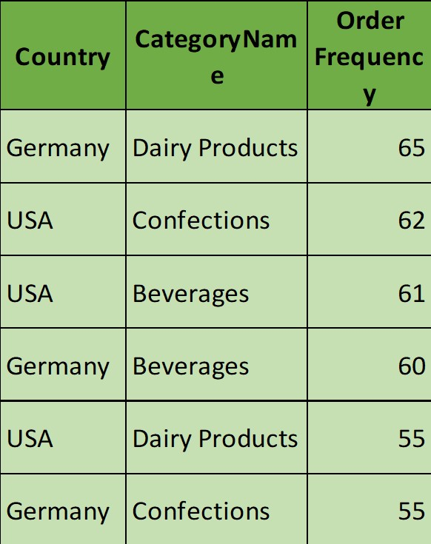
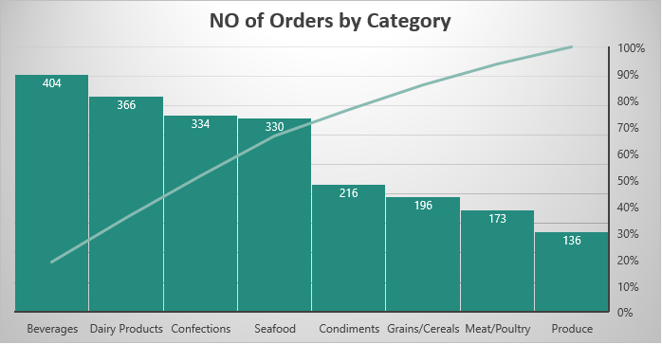
How does order frequency vary across different customer segments? Can we visualize this using bar charts or treemaps ?
The top customers are generally deals in Dairy Products, Confections and Beverages are from Germany fand USA.

Slide 16
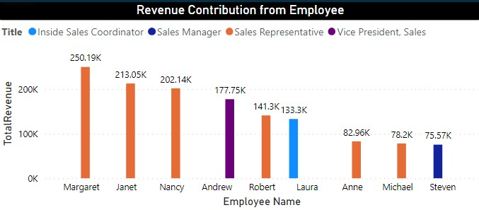
How does employee productivity vary across different departments or job roles? Can we create a stacked bar chart or grouped column chart to visualize it?
The maximum sales are done by sales representative department which around $967K and minimum contribution comes from sales manager $75k though he is only sales manager. Margaret has done maximum sale of $250k.

Slide 17
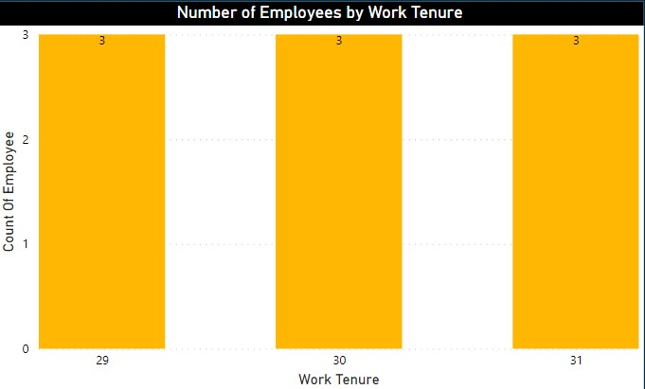
What is the distribution of employee tenure? Can we create a histogram or box plot to display it?
The employees has worked for around 29-31 years of tenure.

Slide 18
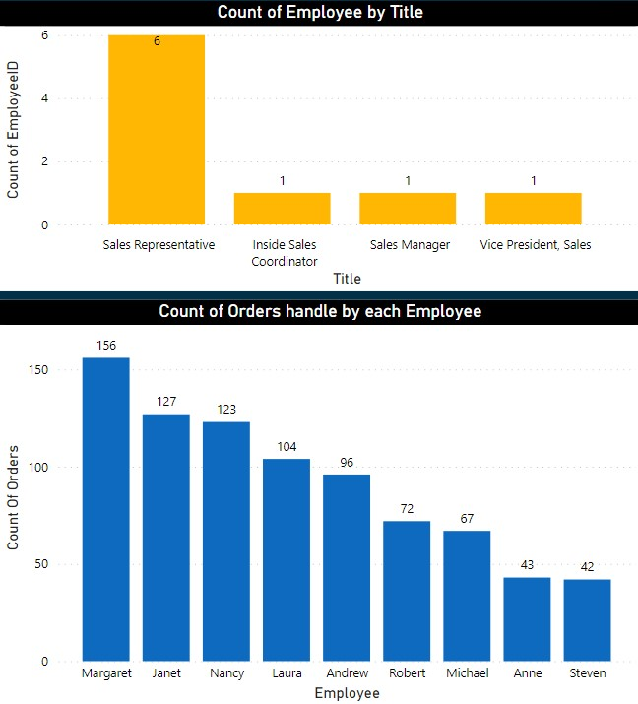
Can we visualize employee performance ratings or KPIs using a radar chart or bullet graph?
The below chart shows the employee name and count of order they have handled. the max orders handle by Margaret.

Slide 19
Are there any correlations between employee satisfaction levels and key performance indicators? Can we explore this visually through scatter plots or line charts?
According to Dataset there is insufficient information about employee satisfaction levels like incentive, bonus, commission etc.
Though there are Key performance indicators but wont be able create correlations.
Can we identify any patterns or clusters in employee skill sets or qualifications through visualizations? How can this information be used for talent management?
From the qualification of employees I can conclude that almost all sales representative have completed their degree in BA or MA with few certification.
Inside sales coordinator has also BA degree but with business certification course.
Sales Manager has BSC degree but he is having experience in sales field.
Vice President in sales has PHD degree due to his skill and hard work he reach this position from sales representative.

Slide 20
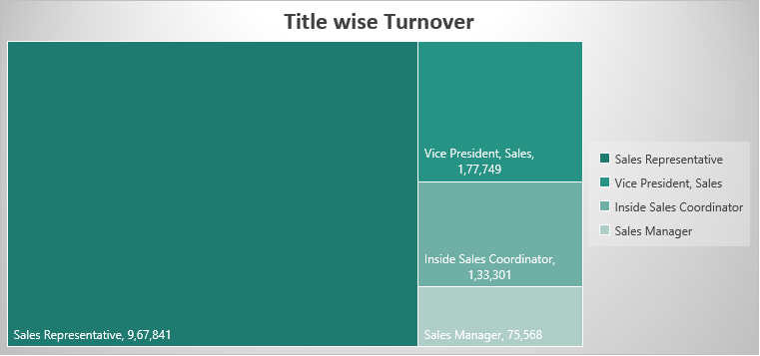
How does employee turnover vary across different departments or job roles? Can we visualize this using bar charts or heatmaps?
The maximum sales are done by sales representative department which around $967K and minimum contribution comes from sales manager $75k though he is only sales manager.

Slide 21
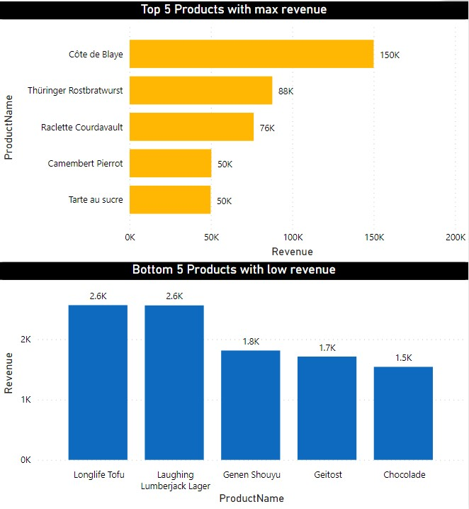
What is the distribution of product ratings or reviews? Can we create a histogram or stacked bar chart to visualize it?
As per data we don’t have Products rating or reviews but we can visualize that The cote de blaye and rostbratwrust has given the max sales where chocolade and geitost has given min sales.

Slide 22
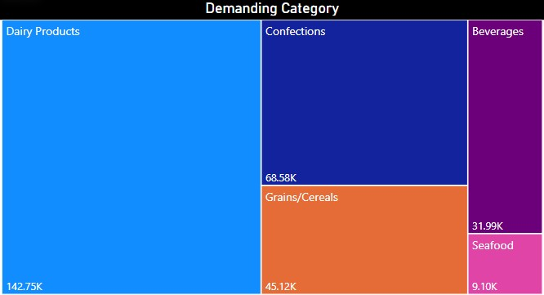
How does the sales volume vary across different product categories? Can we create a bar chart or treemap to display it?
The Dairy Products, Confections and cereals has given max sales.

Slide 23
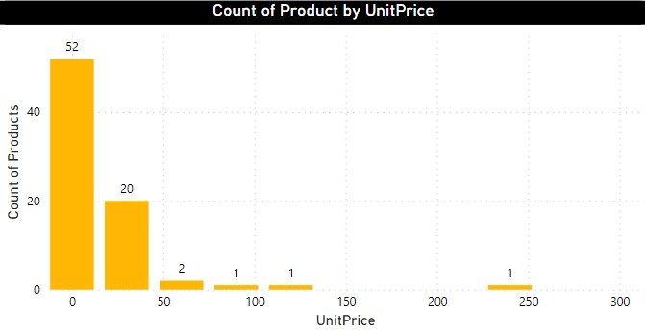
Can we visualize the pricing distribution of products using a box plot or violin plot?
The products ranges from $0-30 are around 52 then 20 products comes between $30-60.

Slide 24
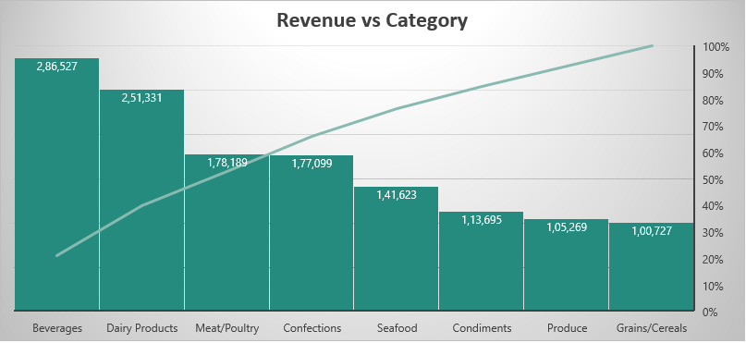
Are there any specific product categories or SKUs that contribute significantly to order revenue? Can we identify them through visualizations?
Beverages and Dairy Products contribution is almost 40% of total revenue.

Slide 25
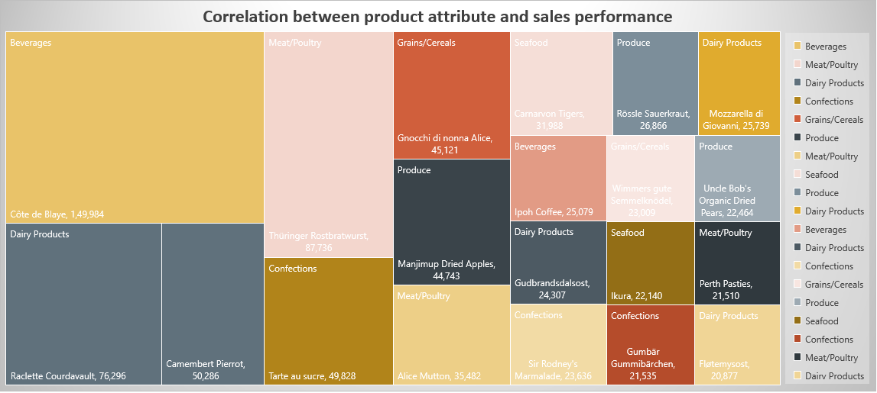
Are there any correlations between product attributes (e.g., size, color, features) and sales performance? Can we explore this visually using scatter plots or heatmaps?
There are top products from each categories Contributing well on total revenue.

Slide 26
How does product demand fluctuate over different seasons or months? Can we visualize this through line charts or area charts?
The products demand keeps very high in the month of April and may and low in July.

Slide 27
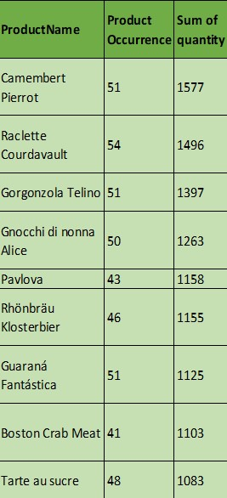
Can we identify any outliers or anomalies in product performance or sales using visualizations? How can this information be used for product optimization?
Camembert pierrot, Raclette, Telino are good performing products while Boston Crab Meat, Raclette Courdavault, Louisiana Hot Spiced Okra, Gudbrandsdalsost, Mozzarella di Giovanni these products got order only once.

Slide 28
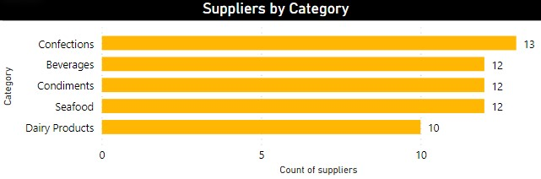
What is the distribution of supplier ratings or performance metrics? Can we create a bar chart or radar chart to visualize it?
There is not sufficient data of supplier ratings or performance metrics. but from below chart we get know number of suppliers for each category

Slide 29
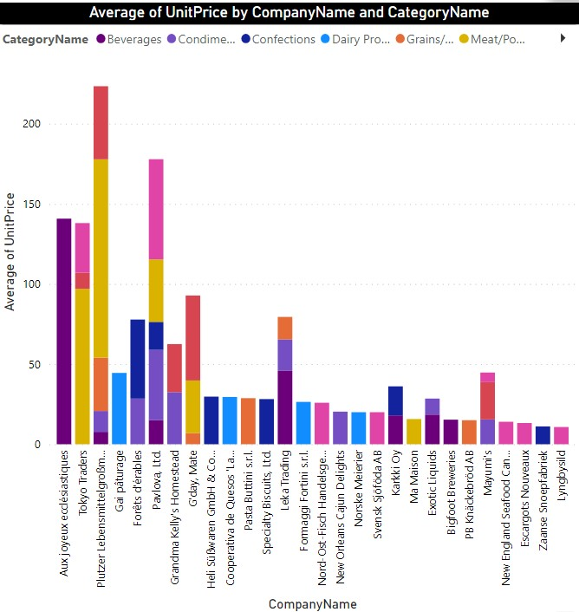
How does the cost or pricing structure vary across different suppliers? Can we create a box plot or stacked bar chart to display it?

Slide 30
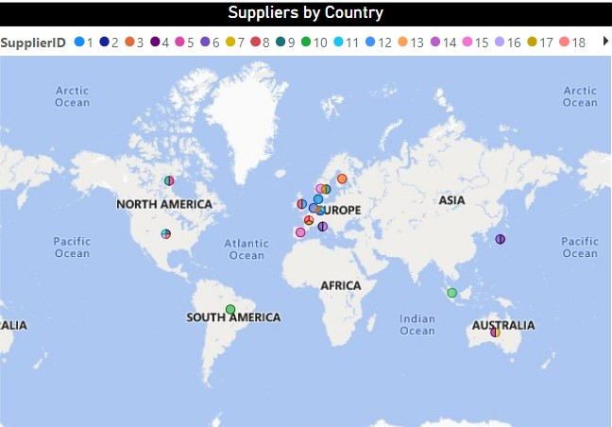
Can we visualize the geographical distribution of suppliers using a map or bubble chart?
As we can see on map most of our suppliers from near Europe region and few from America, Australia.

Slide 31
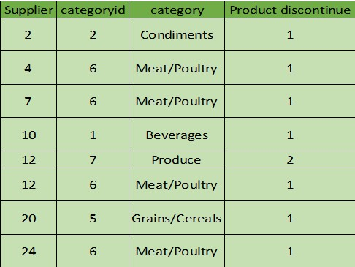
Are there any correlations between supplier attributes (e.g., location, size, industry) and performance metrics (e.g., on-time delivery, product quality)?
There is not sufficient information about suppliers side performance rating, product quality or delivery.
How does supplier performance vary across different product categories or departments? Can we visualize this using stacked bar charts or grouped column charts?
There are few products which are discontinued by suppliers.

Slide 32
Can we identify any trends or patterns in supplier costs or pricing structures through visualizations? How can this information be used for procurement optimization?
From cost structure of dataset we can identify that minimum value for single product is cost from $2.50 Geitost and it gone up to $263.50 which is cote de blaye. Average value cost us for around $28.86.
Aux joyeux ecclesiastiques has $140 Average product price which is maximum and Refrescos Americanas LTDA $10 Average Product price which is minimum.

Slide 33
conclusion
USA
FRANCE
GERMANY
Top Countries by Number of customer
Top 5 Customers by Revenue
Bottom 5 Customers by Revenue
Quick-Stop
GalerÃ­a del gastrÃ³nomo
Save-a-lot-Markets
North/South
Ernst Handel
Laughing Bacchus Wine Cellars
Hungry owl All night-Grocers
Lazy K Kountry Store
Rattlesnake Canyon Grocery
Centro comercial Moctezuma

Slide 34
MAY 1996
Month of highest order
Beverages
Dairy Products
Meat/Poultry
Top Performing Categories
Top Performing Products
Cote de Blaye
Rostbrastwurst
Courdavault
Margaret
Janet
Nancy
Top Performing Employee
8-9 Days
Average Days to Ship Order

Slide 35
Recommendation
Customer and Sales
Scenario
To Gain more loyalty from Customers can given discount regularly
If Possible can reduce shipping days to top customers.
Run Marketing Campaign to gain more sales during occasion or festival.
Expand Opportunities
Maintain good relationship with suppliers or increase the number of suppliers.
Can target region from where customers are not present.

Slide 36
Thank you

